Slide 1
Water Resource Management

Slide 2
Outline
Water Cycle
India’s Water Crisis: Depleting resources, pollution, dams agitations, scarcity.
Sustainable Solutions
Supply Side
Rainwater Harvesting
Watershed Management
Demand Side
Conservation in Agriculture
Conservation in Industry
Conservation in Domestic Use

Slide 3
Water Cycle
Watch Video: The Water Cycle (6.46 min).
Credit: National Science Foundation, Directorate for Geosciences, Division of Earth Sciences. USA. Source: https://www.youtube.com/watch?v=al-do-HGuIk

Slide 4
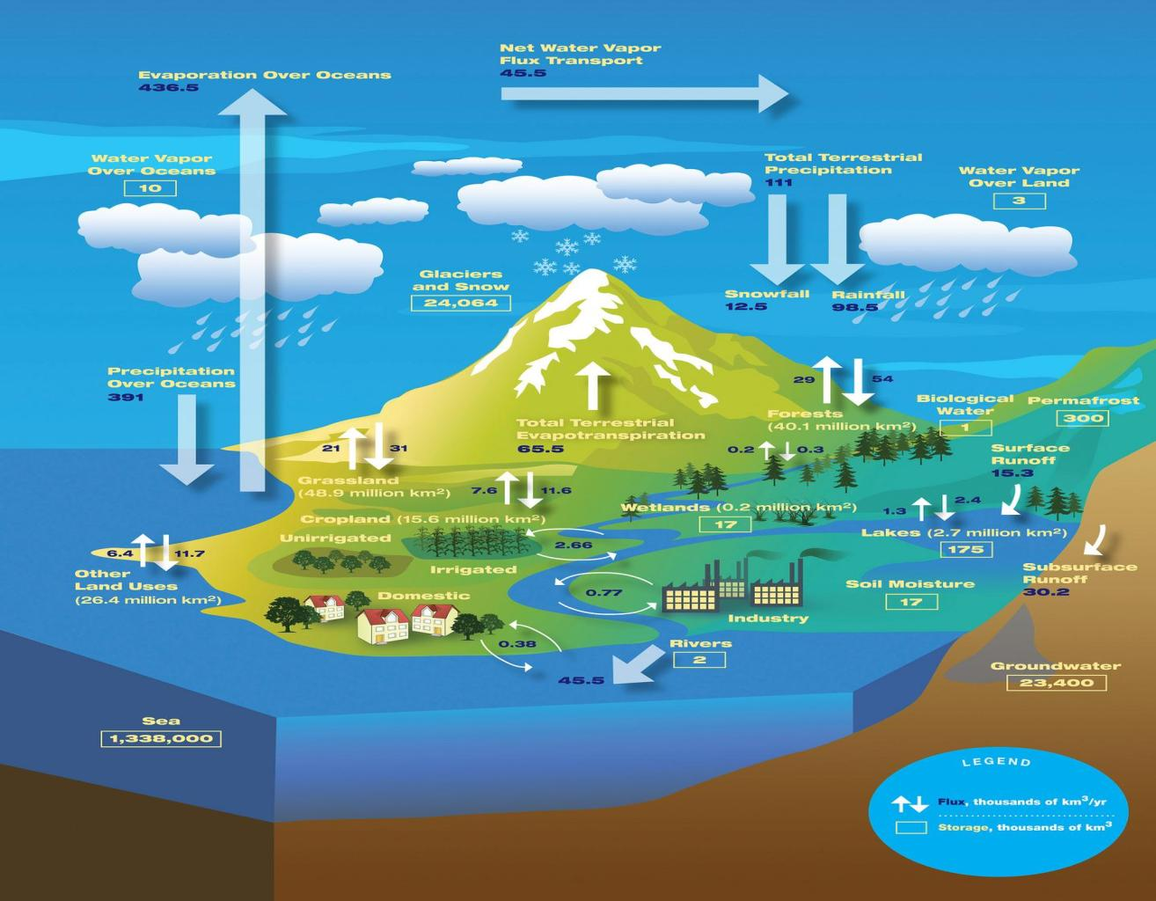
The Hydrological Cycle
Credit: NASA/JPL. Source: https://c1.staticflickr.com/9/8210/8264025043_58e1fbef57_h.jpg

Slide 5
Outline
Water Cycle
India’s Water Crisis: Depleting resources, pollution, dams agitations, scarcity.
Sustainable Solutions
Supply Side
Rainwater Harvesting
Watershed Management
Demand Side
Conservation in Agriculture
Conservation in Industry
Conservation in Domestic Use

Slide 6
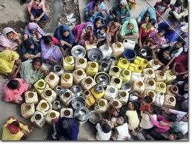
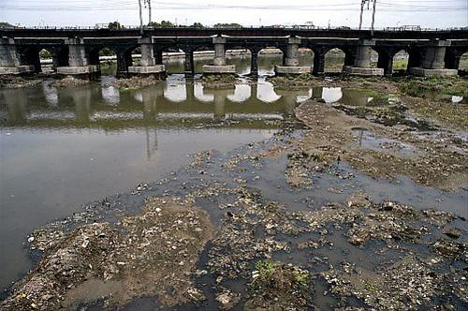
India’s Water Availability
Per capita availability of water is rapidly declining:
Yr. 1951: 5177 m³/yr
Yr. 2001: 1816 m³/yr
Yr. 2011: 1588 m³/yr ^{[ref]}
India is now a water-stressed country (<1700 m³/yr per capita)
128 mi. lack safe water
More than 60,000 villages without a source of drinking water.

Slide 7
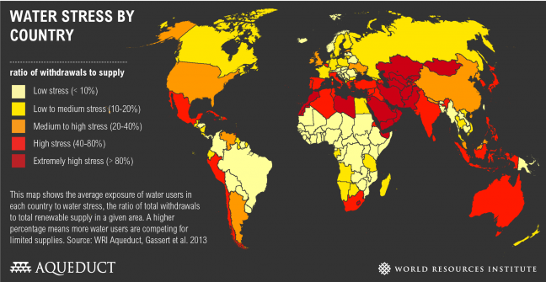
Water-Stressed India
http://www.wri.org/resources/charts-graphs/water-stress-country

Slide 8
Why can’t we build more dams to increase water supply?

Slide 9
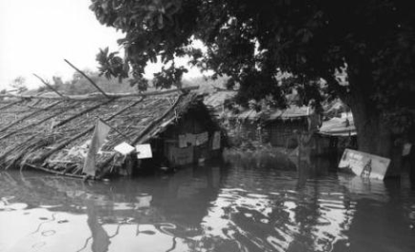
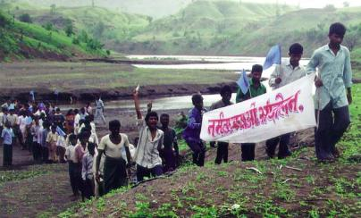
Dammed Rivers--Damned Lives
Unacceptable socio-environmental impacts ^{[ref]}
Unfavorable benefit:cost ratio
Large scale displacements of populations; poor compensation
Disproportionate share of losses borne by people who enjoy little benefits.
Downstream impacts unaccounted.
Reduced sediment and freshwater discharge to floodplains, riverine and estuarine ecosystems.
Severe disruptions in migratory fauna.
Major people’s agitations

Slide 10
Related Reading Material
World Commission on Dams - Dams and Development Project
Report of the World Commission on Dams – UNEP
A Brief Introduction To The Narmada Issue
http://www.internationalrivers.org/

Slide 11
Why can’t we drill more borewells to increase water supply?

Slide 12
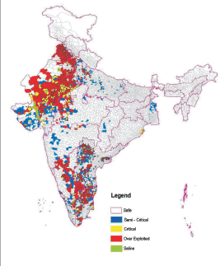
India’s Groundwater Depletion
Groundwater
Feeds 50-75% of agriculture land
600 mi. overly depend on it. [ref]
>90% of it is used for agriculture [ref]
60% will be critically degraded in 20 yrs.[ref]
Alarming depletion of groundwater
Mean rates: 4 cm/yr (17km³/yr)[ref]
Much higher rates locally.
Central Groundwater Board: http://www.cgwb.gov.in/
http://www.cgwb.gov.in/documents/Dynamic-GW-Resources-2004.pdf

Slide 13
Why not interlink the major rivers so that the excess water in one river can be diverted to other rivers which have a shortage?

Slide 14
Inter-linking of rivers
Claimed benefits of interlinking Indian rivers:
No more droughts in the south
No more floods in Ganga and Brahmaputra
More power – 30,000 MW of hydropower will be generated

Slide 15
Inter-linking of rivers
Budget Rs. 5600 to 10,000 billion
Lowest estimate equals to 25 % of GDP, 2.5 times of our tax collection
Funds to be raised from international sources
Even if we succeed in raising funds annual interest alone would amount to Rs. 200-300 billion
Water will have to priced high

Slide 16
Inter-linking of rivers
Issues
People’s and political willingness to share water
Not yet clear whether rivers like Ganga, Brahmaputra, Mahanadi and Godavari are water surplus – as the sources of these rivers are drying up and rivers themselves choked with silt
Ecological consequences of building over 200 reservoirs and network of canals cannot be assessed

Slide 17
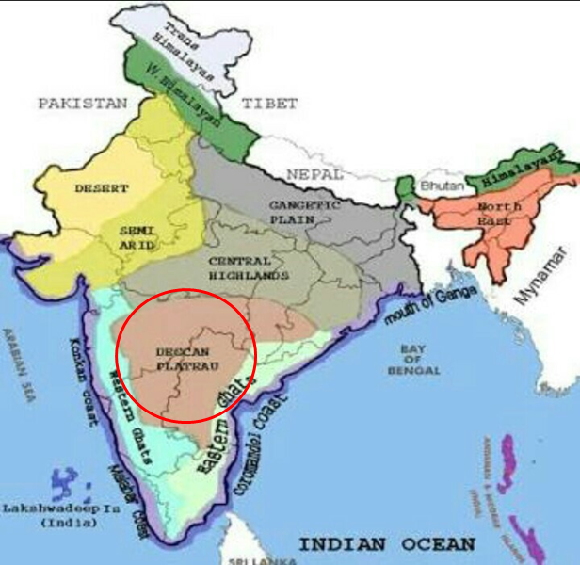
Inter-linking of rivers
Issues
Large quantity of electricity needed to pump enormous quantity of water over the elevated Deccan Plateau

Slide 18
Inter-linking of rivers
Issues
Submergence of habitats, forests and fertile land
Destruction of wildlife and biodiversity
Displacement of large populations of people

Slide 19
If water availability is reducing, why not reduce water use?

Slide 20
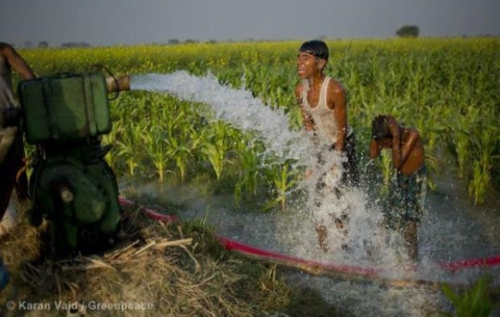
Complications: Food Crisis
>78% water goes for agriculture.
Food for the growing population
Increased irrigation demands
>50% food comes from irrigated land (35% of arable land).
Yields of rainfed arable land (65% of total arable) low due to lack of irrigation and land degradation.
Reducing water use directly conflicts with food production.

Slide 21
But India is supposed to be the land of great rivers and lakes.
What has become of them?

Slide 22
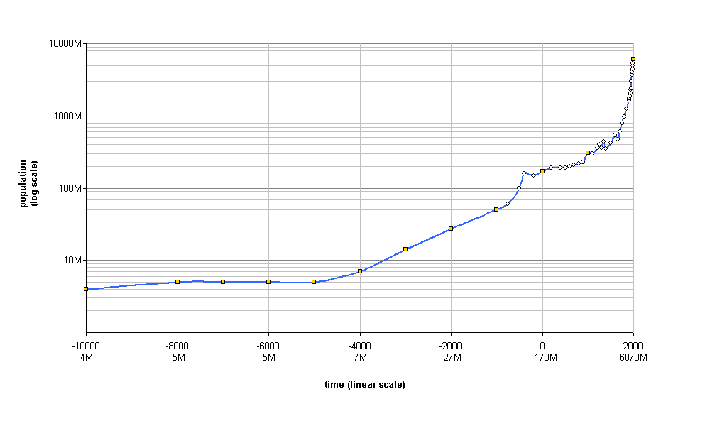
India’s Population Growth
World Population
Credit: Waldir. Source: http://en.wikipedia.org/wiki/Demographic_history
India’s Population ^{[ref]}
1950: 359.0 mi.
2014: 1238.9 mi.
India has some of the highest population densities in the world.

Slide 23
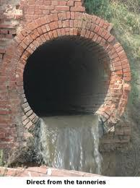
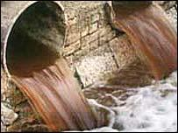
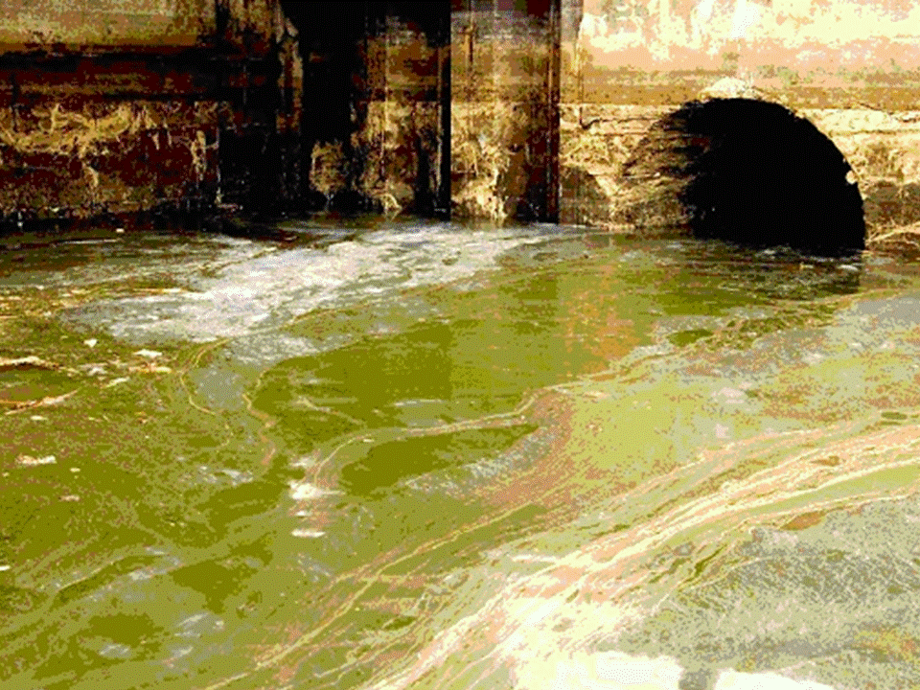
India’s Water Pollution
>70% of India’s surface water resources are polluted by sewage and toxic chemicals [ref]
Sewage treatment facilities in towns and cities:
Full facilities in only 8 cities[ref]
Partial facilities in 209 (6.7%) out of 3,119.
Over 114 Indian cities dumping untreated sewage and partially cremated bodies directly into the Ganges. [ref]
Tannery Waste Containing Chromium Dumped in the Ganges

Slide 24
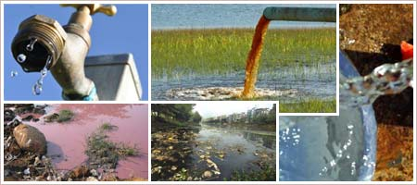
India’s Sewage Treatment
Installed sewage treatment capacity in India's Class I cities and Class II towns in 2008: ^{[ref] [ref]}
Only 31.3% (11787 MLD) of total sewage generated (38254 MLD).
i.e. 68.7% of sewage is discharged untreated
Treatment is virtually nonexistent in smaller towns

Slide 25
If the water is polluted, we must provide purified drinking water to all
Purifying heavily polluted water is expensive!
Contaminants can include, particulates, dissolved (ionic) impurities, biological contaminants, heavy metals and organic chemicals.
The cheaper methods of drinking water treatment are often inadequate to remove all the above contaminants.
The more comprehensive and sophisticated methods are expensive.
The poorest in the country are hardest-hit by poor water quality.
DRINKING WATER SPECIFICATION: IS: 10500, 1992
WHO Guidelines for drinking-water quality
WHO Guidelines for Recreational, or bathing, waters

Slide 26
Then let's develop innovative cheap water filters or some other technology to purify water.
Firstly, purifying heavily polluted water is not cheap.
Besides, this simplistic approach completely misses the complexity of the issue.
Uncontrolled pollution and depletion of water resources and mismanagement of wastewater are also part of the problem. The solution should give consideration to all these aspects.
It means we must first understand these aspects adequately...

Slide 27
Come on! There’s no need to panic...Indians have a tough immune system...our bodies can surely handle a little water contamination...

Slide 28
Health Effects of Water Pollution
Water, sanitation, and hygiene-related deaths: 0.4 mi./yr. (WHO 2007).
The socio-economic costs of water pollution are extremely high: 1.5 mi./yr. children ( <5 yrs. ) die due to water related diseases,
200 mi. person-days of work are lost each year in India.
National loss of INR 366 bi./year due to water related diseases (Parikh 2004).
http://www.idfc.com/pdf/report/2011/Chp-19-Water-Pollution-in-India-An-Economic-Appraisal.pdf
" No single measure would do more to reduce disease and save lives in the developing world than bringing safe water and adequate sanitation to all."
- UN Secretary General Kofi Annan

Slide 29
Ok, fine. How do the infections get into our drinking water anyway?
Through untreated sewage entering water sources
and
OPEN DEFECATION
Rain washes it all into our water bodies.

Slide 30
India’s Sanitation
No sanitation services for 839 mi.
Open Defecation
India: >50% population (638 mi.)
Bangladesh and Brazil: 7%
China 4%
[ref] | Urban | Rural | Total
Improved water supply | 96% | 84% | 88%
Improved sanitation | 54% | 21% | 31%

Slide 31
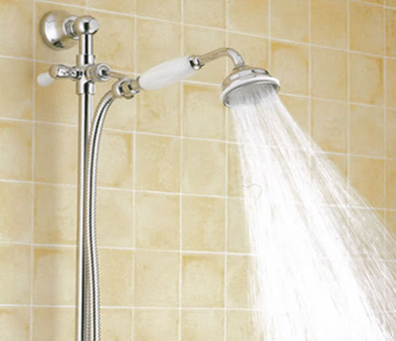
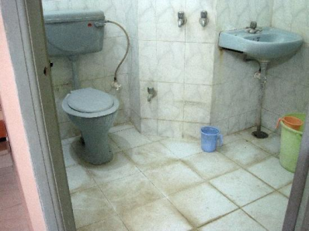
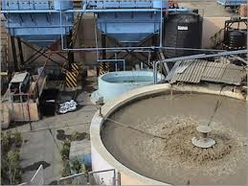
Providing Sanitation
Improved water supply and sanitation increases water demand
But supply is already short of the demand.
It also increases the sewage to be treated
Installed treatment capacity is already far short of the requirement.

Slide 32
So the solution is simple: simply provide modern sanitation to all.

Slide 33
Then let’s treat all the sewage with the well-established sewage treatment technologies.

Slide 34
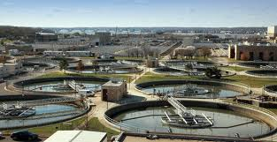
Cost of Sewage Treatment
Energy costs of treatment
Conventional: 320 KWh/ML [ref]
Breakup of energy consumed
Aeration 60%
Anaerobic 11%
Pumping 12%
Energy requirements for treatment
9280 MWh/day (29000MLD x 320 KWh/ML with only 31% population having improved sanitation
13,449 MWh/day if 100% population enjoys improved sanitation.
In a country undergoing an ENERGY CRISIS, how can we spend large amounts of power for treating sewage?
Notes:
India’s installed electricity generation ~260 GW
India’s daily electrical units generated (5614 GWh/day.)

Slide 35
There are many other related complicating factors…
For instance, lack of irrigation is not the only reason for low agricultural productivity...

Slide 36
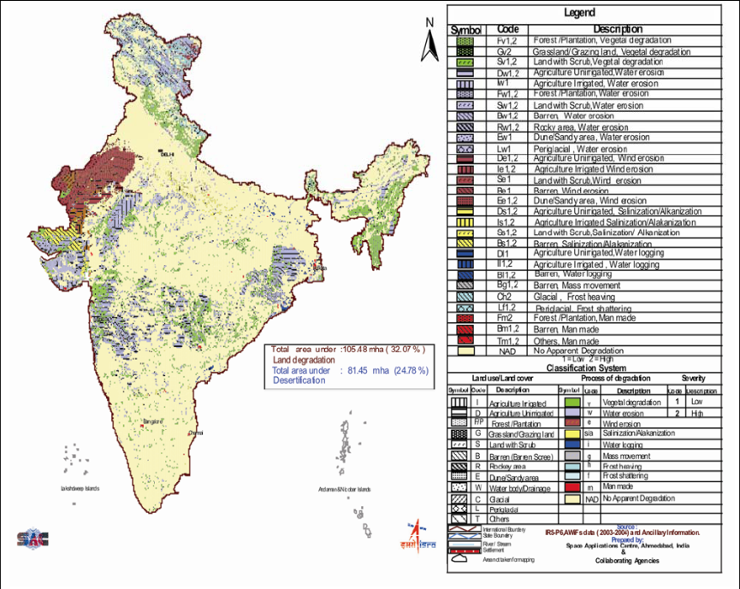
Complications: Land Degradation
Land Degradation: 105 mi. ha (32.07%)
Desertification 81.45 mi. ha (24.78%)
Productivity loss of Rs. 28,500cr./yr
Equivalent to 12% loss in total value productivity of these lands.
Organic carbon inputs can be beneficial
Source: DESERTIFICATION & LAND DEGRADATION ATLAS OF INDIA Space Applications Centre (SAC), ISRO, 2007. http://www.moef.nic.in/sites/default/files/desert_atlas.pdf

Slide 37
Many socio-environmental problems are related to overcrowding and unplanned urbanization…
Bad governance is of course an important factor causing unsustainability...
So solving India’s water crisis, is not going to be easy.

Slide 38
Activity: Water Quality in Nearby Sources
Choose a nearby river, lake, or groundwater source.
It may be conducted as a:
Field trip + Home Assignment
Home Assignment
Class Activity (by teacher providing necessary data).
Have them fill out a form with the relevant information:
Use internet resources, newspaper clippings
Contact government bodies
Contact local NGOs working in the field of water.
Compare it with IS: 10500 or WHO Guidelines
Identify main water quality issues (eg. hardness, coliform organisms, specific contaminants etc.)
Identify other issues (such as eutrophication, drying out, flooding, etc.) and their causes.

Slide 39
Outline
Water Cycle
India’s Water Crisis: Depleting resources, pollution, dams agitations, scarcity.
Sustainable Solutions
Supply Side
Rainwater Harvesting
Watershed Management
Demand Side
Conservation in Agriculture
Conservation in Industry
Conservation in Domestic Use

Slide 40
Evolving Solutions
Coordinated efforts from various sectors and agencies are required.
Interventions in two areas required:
Making more water available (Supply side)
Rainwater Harvesting
Watershed Management
Using water efficiently, without polluting resources (Demand Side)
Agriculture
Industry
Domestic

Slide 41
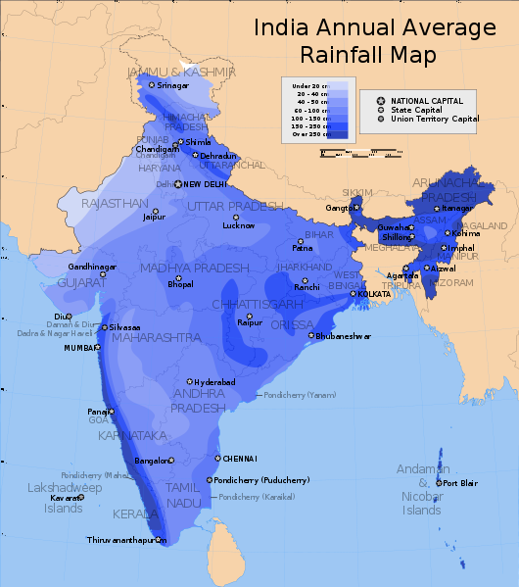
India's Rainfall
>80% of India gets at least 40 cm rain.
Watershed management and rainwater harvesting is convenient for most places in India.

Slide 42
Solutions: Rainwater Harvesting
Rainwater harvesting^{[ref]} for drinking water
Need: 5 L/capita/day; 1825 L/capita/yr
Collection: L/m²/capita per cm of avg. annual rainfall.
Assuming >70% India gets at least 40 cm rain.
>70% population has more than 5 m²/capita roof area
With 5 m² roof area and 40 cm rain, 2000L can be collected.
Storage costs: Rs. 0.50-10/L (Rs. 1000-20,000/capita)
Cost reduction through community self-help.
Excess collected water to recharge aquifer through borewell or recharge wells.

Slide 43
Drinking Water: Collecting and Storing; Not Purification
Water purification to drinking standards
Requires removal of hardness, dissolved organic and ionic contaminants, and disinfection.
High technology problem: desalination, ultrafiltration etc.
Cost reduction requires technological advances.
Collecting and storing (already clean) rainwater
Low tech problem, with different cost options.
The lower cost options are communal storage, which involve the community owning up the responsibility to build and maintain the clean drinking water infrastructure.
More consistent with a sustainable community development.

Slide 44
Activity: Rainwater Harvesting for Your Home
Calculate the total rooftop area for your family and per capita.
Find out the average annual rainfall for your city
Calculate the amount of rainwater falling on your roof that can be stored
Assume 20% losses (evaporation and first wash rejected).
Design your own rainwater harvesting system, employing the local plumber.
Calculate system cost.

Slide 45
Other high tech and high cost options to purify water may be used in the limited cases and regions, where rainwater harvesting is not possible.

Slide 46
Outline
Water Cycle
India’s Water Crisis: Depleting resources, pollution, dams agitations, scarcity.
Sustainable Solutions
Supply Side
Rainwater Harvesting
Watershed Management
Demand Side
Conservation in Agriculture
Conservation in Industry
Conservation in Domestic Use

Slide 47
How to ensure that enough water is made available for all our other requirements?

Slide 48
Making More Water Available
Water circulates in the biosphere through the Water Cycle.
Water is directly useful for humans in only part of that cycle: from rainfall to until it flows to the sea.
India’s monsoon: 80% of rainfall in June-September ^{[ref]}
Good management of water during this part can significantly increase both the quality and quantity of water available.
This is called Watershed Management.
Let’s first try to understand what is meant by a Watershed.

Slide 49
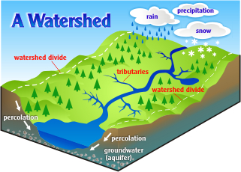
Watershed
Credit: Pennsylvania Department of Environmental Protection. Source: http://www.portal.state.pa.us/portal/server.pt?open=514&objID=588795&mode=2
The area from which all the water flows to the same place (larger river, lake or ocean.)
It contains streams, rivers and underground flow.
Smaller watersheds (the size of a village) are part of larger watersheds (size of states).
Natural ecosystems (forests, wetlands) are part of the watershed.
Our homes, roads, cities are part of some watershed.
Pollutants are carried downstream with the water.

Slide 50
Slowing the Flow of Water
The basic principle is to slow down the flow of water after rainfall.
Water flowing over the surface can reach the ocean in a matter of days...no water for the dry months.
Water that is held up in tanks, or which infiltrates the ground, takes months or years to reach the ocean...and can be used during the dry months.
Adequate availability of water, more even distribution (in space and time) and its quality depends on good management practices throughout the watershed.

Slide 51
Natural Ecosystems Are Essential
Natural ecosystems (consisting of plants) are part of watersheds and are essential in maintaining their health.
They improve the quality and quantity of water and available to humans.
Let’s see how...

Slide 52
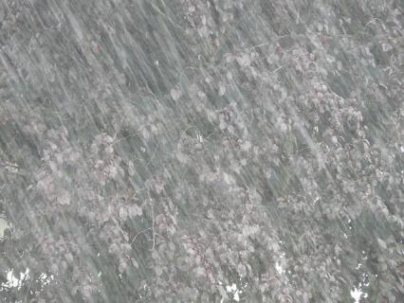
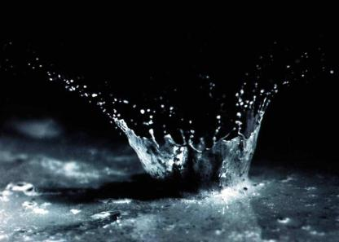
How Do Plants Protect the Soil and Water?
Raindrops impact the soil at their terminal velocity (At sea level, 7.2-32 km/h. ^{[ref]}
Create small craters,^{[6]} & eject soil particles upto 0.6 m vertically and 1.5 m horizontally.
If soil is vegetated or covered with ground litter, the impact is intercepted.
Water trickles gently to the soil, preventing soil damage.
Image 1 Credit: Hans Braxmeier, Pixabay. Source: http://pixabay.com/en/downpour-rainstorm-rain-shiver-wet-8823/
Image 2 Credit: US Department of Agriculture - WEPP 95 CD-ROM, Source: http://en.wikipedia.org/wiki/Erosion#mediaviewer/File:Water_and_soil_splashed_by_the_impact_of_a_single_raindrop.jpg

Slide 53
Vegetated Soils Reduce Runoff
Vegetation slows runoff velocity: limits sheet erosion.
Roots hold the soil; prevent gully formation.
Vegetated soil (shade and ground litter) provides shade and moisture for soil creatures that burrow and turn the soil.
The plant root mass and ground litter adds organic matter to soil, which provides nutrients and soil carbon (humus) to the soil; improves fertility.
Some plants fix nitrogen and improve fertility.

Slide 54
How Do Plants Protect the Soil and Water?
Soil rich in organic carbon → absorbs water like a sponge→ greater moisture retained → improved productivity of the the land.
Such soil has a crumbly structure (high porosity). Also, it has burrows of soil organisms like earthworms.
This leads to high rates of ground infiltration of rainwater→ high aquifer recharge; reduced runoff.
Reduced runoff and reduced silt load.

Slide 55
Plants--Essential for Water Management
Rain falling on→ Causes: | Barren Land | Vegetated Land
Direct impact of raindrops on soil | Yes | No
Loss of soil structure, soil erosion | Yes | No
Ground infiltration, aquifer recharge, slow discharge to streams and rivers throughout the year | Low | High
Surface runoff and downstream flooding, silting of downstream dams. | High | Low
Potential downstream usability of water by humans throughout the year (via wells, borewells and rivers) | Low | High

Slide 56
Watershed as a Whole
As water flows downstream after rainfall we must:
Slow it down to prevent erosion.
Store it in tanks, ponds and lakes wherever possible.
Encourage ground infiltration (aquifer recharge).
Prevent pollution (urban or agricultural pollution)
Prevent over-extraction. Plan water use based on availability.
Minimize leakages and evaporative losses
Consume consciously.

Slide 57
Watershed Management Practices
Protection of vegetation in the catchment (control of deforestation, overgrazing and fire).
Terracing, contour trenches, planted bunds, swales.
Tanks, Farm ponds, percolation tanks.
Check-dams, small and medium dams.
Prevention of overuse and wastage of ground and surface water.
Planting of water conserving and locally & seasonally adapted crops.
Prevention of water pollution.
Watch Video: Watershed Management (2.10 min)
Credit: WOTR India. Source: https://www.youtube.com/watch?v=Nk58syLzMF8

Slide 58
Flood Management in Watersheds
Reducing the scale of floods through better catchment management, controlling runoff, and protection of wetlands.
Multiple small dams (with fish ladders etc), bunds, percolation tanks throughout catchment
Isolation of flood threat by flood embankments, flood proofing and limiting floodplain development.
Increasing people's coping capacity with emergency planning, forecasting, warnings, evacuation, compensation and insurance.

Slide 59
Energy in Watersheds
Large hydroelectric projects generate large amounts of power but have high socio-environmental costs.
Alternative watershed management programs can also generate power by:
Distributed micro-hydro (<100KW) & mini-hydro (<10MW) projects.
Deploying other renewable energy sources such as wind, solar and biogas throughout the watershed...

Slide 60
Need for Community Involvement
Community-driven, awareness, education, gender-equality, justice, local livelihood generation.
Watch Videos: Hiware Bazar: The town of 52 Millionares (9 min).
The ideal village in india -- hiware bazaar (8.43min)
Credit: Leah Temper, CEECEC. Source: https://www.youtube.com/watch?v=0GrUvNHYO_k

Slide 61
Dying wisdom
Ancient methods intercepted the flow of water without ecological disturbance.
Hill and mountain regions:
Diversion channels (guhls and kuhls of western Himalaya).
Arid and semi-arid regions:
Tanks (the eri system of Tamil Nadu).
Checkdams (johads of Rajasthan).
Plains and floodplains:
Inundation channels (West Bengal).
Coastal area:
Control saline water intrusion(khazana lands of Goa).
Low cost, community controlled, adapted to local ecology and offered protection from droughts and floods.

Slide 62
Activity: Identify Your Watershed
Which watershed do you belong?
Classify: Well-vegetated, partly, degraded, urban
What are the major issues?
Intervening for Solutions:
Identify governmental agencies
Identify NGOs
Form or join citizens groups
Industry associations
Legal instruments

Slide 63
National Rural Employment Guarantee Act
Watershed Works Manual 2006

Slide 64
Outline
Water Cycle
India’s Water Crisis: Depleting resources, pollution, dams agitations, scarcity.
Sustainable Solutions
Supply Side
Rainwater Harvesting
Watershed Management
Demand Side
Conservation in Agriculture
Conservation in Industry
Conservation in Domestic Use

Slide 65
Once we have enough water available for our use, how can we maximize its benefit?
Or how do we use the minimum water to get the desired benefit?

Slide 66
India’s Water Consuming Sectors
Sector | 2010 | 2050
Agriculture % | 78 | 68
Industry % | 6 | 7
Power Development % | 5 | 6
Domestic % | 3 | 9.5
Other % (evaporation, environment, navigation) | 8 | 9.5
TOTAL (BCM*) | 710 | 1180
* Billion cubic meter
The National Commission for Integrated Water Resources Development (NCIWRD)

Slide 67
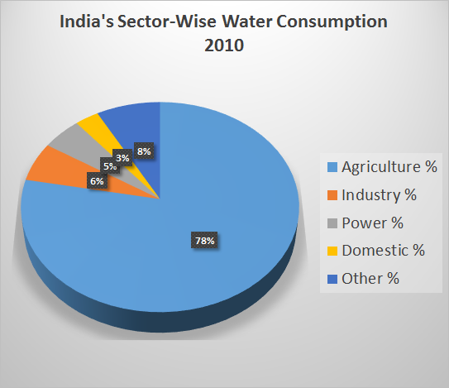
2010

Slide 68
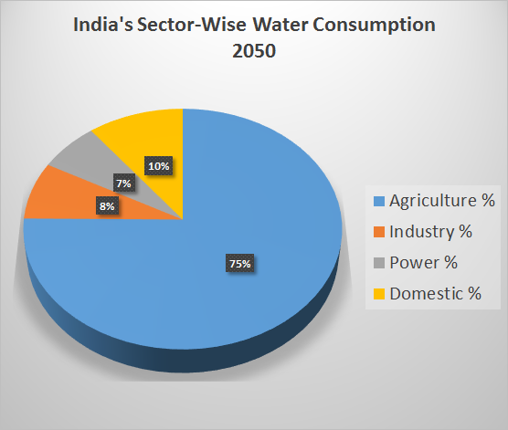

Slide 69
Water in Agriculture (78% of total)
Water, agriculture, food and waste are inseparable.
78% water goes for agriculture.
>50% food comes from irrigated land (35% of arable land).
Land Degradation (loss of soil carbon and moisture) affects 105 mi. ha (32.07%)-- A Rs. 28,500cr./yr loss of productivity.
Low input organic polycultures (agro-ecosystems) can revolutionize agriculture and water use.
Yields of rainfed arable land (65% of total arable) can be improved drastically (15-150%)
Can drastically reduce the water use of irrigated lands while providing the same yield.
Inputs of carbonaceous waste to soil can drastically improve productivity & reduce water use.

Slide 70
Food, Water, Land
Watch:
Change the Way You Think About Food (2.16min). --WWF.
300 Year Old Food Forest in Vietnam (6 min)

Slide 71
Low Input Organic Polycultures
Need to develop highly productive low input polycultures/ intercropping/ agro-ecosystems with the following features:
Max. food calories/liter water ^{[ref]}.
High diversity including alternative crops such as minor millets and vegetables, tree crops etc.
Crops adapted to local conditions: temperature, drought, salinity, pest and disease resilience etc. so that minimum inputs are required.
Strategies such as mulching, biochar amendment to reduce soil water evaporation, retain soil moisture and nutrients.
Use conservation irrigation practices such as drip irrigation.
Using greywater / reclaimed water for irrigation.
Conservation-favoring water tariffs, regulation, subsidies.

Slide 72
Industrial Water Use (6% of total)
Industry runs to provide us with the products we buy. All of them need water and energy to make, distribute, use and discard.
All products contain embodied water:
Potato (100g) 25L
Slice of bread (30g) 40L
Cup of coffee (125ml) 140L
Bag of potato crisps (200g) 185L
Glass of milk (200ml) 200L
Hamburger (150g) 2400L
Cotton T-shirt (medium, 500g) 4100L
Pair of shoes (bovine leather) 8000L
Your shopping drains the nation of water and energy!
Reducing consumerism reduces the crisis in water and energy.

Slide 73
Outline
Water Cycle
India’s Water Crisis: Depleting resources, pollution, dams agitations, scarcity.
Sustainable Solutions
Supply Side
Rainwater Harvesting
Watershed Management
Demand Side
Conservation in Agriculture
Conservation in Industry
Conservation in Domestic Use

Slide 74
Industrial Water Use
Specialized treatment is needed for industrial effluent.
Green chemistry and green production processes can reduce the environmental impacts significantly.
Industries must gradually evolve towards recycling water 100%; closed loop production.
This can raise production costs & encourage conscientious consumption.
Industrial symbiosis networks can allow exchange of material and energy streams between processes within the same industry and other industries and industry to non-food agriculture.
Use low-energy water treatment and recycling where water is free of persistent and highly toxic pollutants.
e.g. Planted filters, constructed wetlands, soil biotechnology (IIT-B), DEWATS etc.

Slide 75
Case Studies of Industries having closed the water loop. ^{[ref]}

Slide 76
Outline
Water Cycle
India’s Water Crisis: Depleting resources, pollution, dams agitations, scarcity.
Sustainable Solutions
Supply Side
Rainwater Harvesting
Watershed Management
Demand Side
Conservation in Agriculture
Conservation in Industry
Conservation in Domestic Use

Slide 77
Domestic Water Use in India (3-5% of total)
Local scarcities are common: high pop. density relative to water availability.
Sewage contamination is a major contributor to water pollution.
70% surface water sources polluted.
68% wastewater is discharged into river, lakes and ground, untreated.
Conventional treatment costs are high; but alternatives exist.
Sewage contains Rs 1,091 mi. of agro-fertilization value that is lost annually. Can we recover this value?

Slide 78
Greening Domestic Water Use
Integrated water, energy, waste disposal and food production systems at household/community scale.
Eliminate persistent chemicals from the water use cycle to facilitate recycling and reuse.
Separation of greywater from blackwater (approx. 50-50 proportion)
facilitates water reuse
reduces energy consumption and cost of treatment.
Composting toilets can
Reduce the household water use by nearly 50% (flush-free)
Save a lot of energy.
Yield compost with high nutrient value for agriculture or gardening.

Slide 79
Alternative Wastewater Treatment Methods
Alternative methods of wastewater treatment can save a lot of energy (& money):
Conventional: 1800-8000 KWh/MG
Alternative method (Video: Soil biotech method, IITB 7.28 min): 0.01 KWh/MG [ref1 ref2 ref3]
Planted filters, constructed wetlands, DEWATS etc.
Provide substantial benefits (like compost, agricultural produce, biogas etc.)
Can have longer treatment times and greater land requirements.

Slide 80
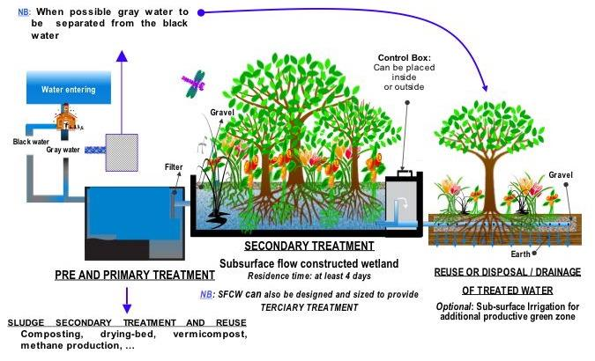
Alternative Wastewater Treatment
Subsurface flow constructed wetlands (SFCW)
http://upload.wikimedia.org/wikipedia/commons/7/73/SchemConstructedWetlandSewage.jpg

Slide 81
Domestic Effluent (Sewage)
Simple system
Low output of value-added products
High external inputs
Lower infrastructure
Lower long-term profitability
Effluent Treatment Plant
High electricity, inputs
Sludge
Land Application
(Pollution?)
Reclaimed Water

Slide 82
Complex system
High output of value-added products
Low external inputs
Higher infrastructure
Drastically higher long-term profitability
Domestic Effluent (Sewage)
Open wetland with ducks
Plant Biomass (e.g. water hyacinth, algae)
Biogas or Pyrolysis Plant
Adapted from: http://www.indiangreenservice.com/resources.html
Reclaimed Water
Eggs
Energy

Slide 83
Solution for Multiple Related Problems
A water-management strategy that:
Treats wastewater to domestic use quality (pathogen removal, BOD reduction, turbidity and odor removal).
Provides reclaimed water (reduces the need to extract water from environmental sources.)
Consumes less energy or...PROVIDES ENERGY!!
Is low cost or...GENERATES REVENUE!!
Consumes less space or provides multiple uses of the same space.
Provides other products such as food or wood (reduces the need for irrigation elsewhere)
Reduces problems of urbanization by providing green spaces, recreation.

Slide 84


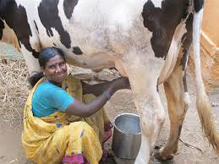
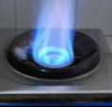
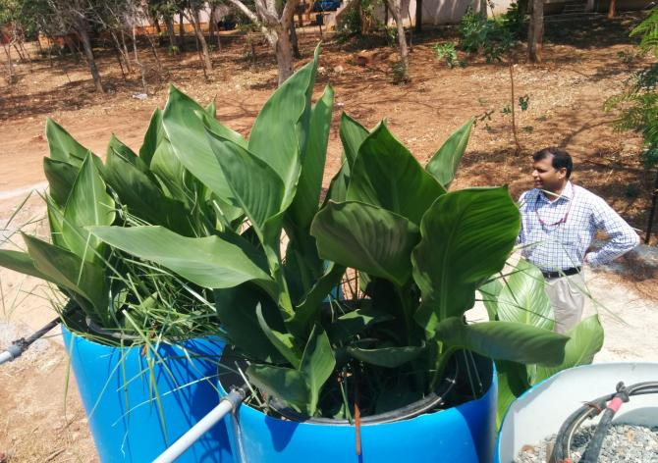
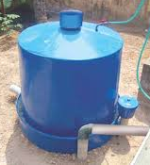
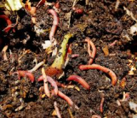
Schematic of a Multi-Utility System
Food Waste
Milk
Biogas
Treated water for domestic use
Food
Sewage
Cattle feed
cattle waste
Biodigester effluent
Vermicompost
Sludge

Slide 85
Potential System Outputs
Treated water returned for domestic use.
Vermicompost
Biogas
Food (fruits and vegetables)
Milk
Wood

Slide 86
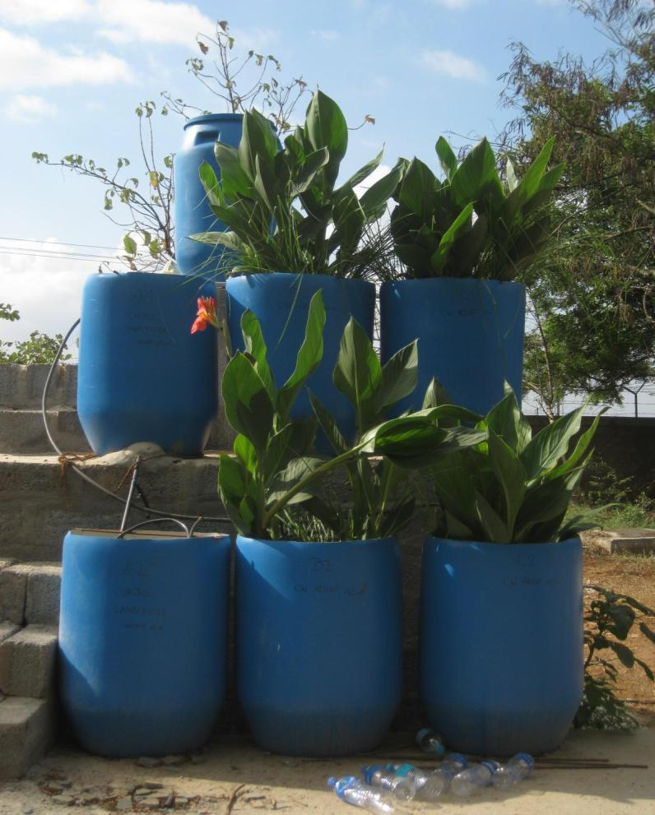
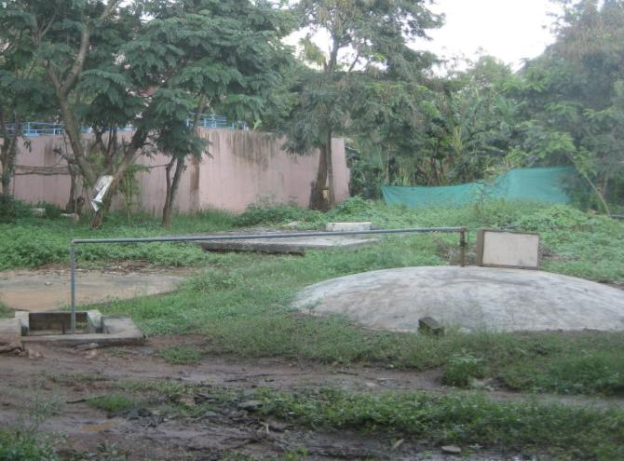
Planted Filter

Slide 87
Watch Video: Smart & Ecological Use of Roofs (5.10)
Relevant resources: http://www.sswm.info/

Slide 88
What can I do?
Minimize personal water use (domestic, gardening, etc)‏
Consume only what you need. Shop less and waste nothing!
Install/build home greywater recycling systems.
Use the recycled water for a kitchen garden.
Install water-conserving toilets or composting toilets
Close / repair leaking taps
Use natural domestic and personal cleaners and cosmetics. Avoid toxic chemicals in the home and garden.
Install rainwater harvesting.
Disseminate information on efficient technologies, organic farming.

Slide 89
Thank You!

Slide 90
Extra Resources
What is Watershed Development? (2.10min)
Drainage System in India | 3D Animated Education Video of Class 9, 10 | ncert history (9min)
Environmental Science videos on Consortium on Educational Communication-UGC.

